Slide 1
EXCEPTION HANDLING FUNDAMENTALS
MODULE - 5
and
TECHNIQUES

Slide 2
INTRODUCTION OF EXCEPTION
Exceptions occur at runtime, not during compilation.
They can be caught and handled using special blocks like try, catch, and finally in Dart.
Handling exceptions helps prevent the program from crashing unexpectedly.
Exception handling is a very important part of programming because it helps make your programs more reliable, safe, and user-friendly.

Slide 3
HANDLING EXCEPTION
TRY :
The try block contains the code that may cause an exception during program execution.
The on block is used when you know the specific type of exception you want to handle.
The catch block is used to handle the exception if any error occurs in the try block.
The finally block is always executed, whether an exception occurs or not, usually for cleanup actions.
void main() {
try {
// Code that might throw an exception
} on IntegerDivisionByZeroException {
// Code for handling exception
} catch (e) {
// Code to handle any other type of exception
} finally {
// Code that always executes
}
}
ON :
CATCH :
FINALLY :

Slide 4
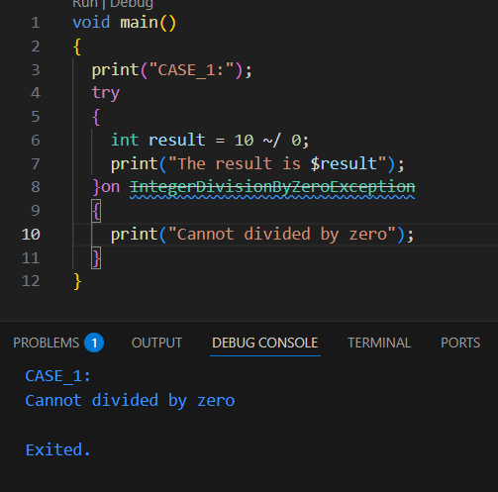
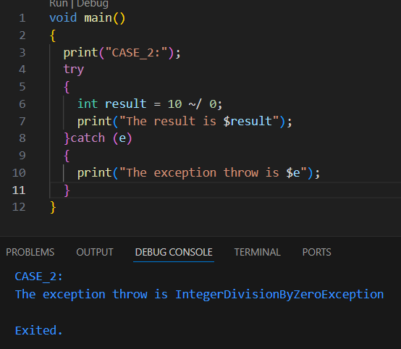
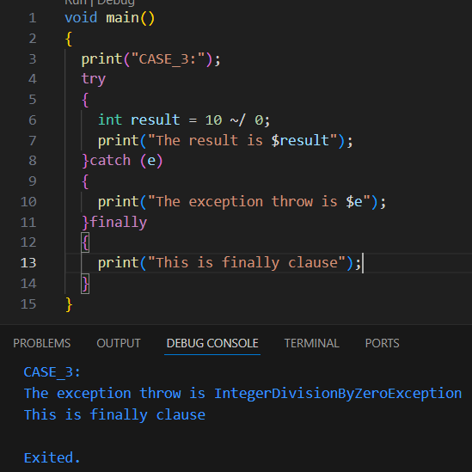
EXAMPLE OF HANDLING EXCEPTION

Slide 5
EXCEPTION NAME | DESCRIPTION
DeferredLoadException | Thrown when a deferred library fails to load at runtime. This usually happens if the program tries to load a part of the code (library) that was not properly compiled or linked.
FormatException | Thrown when a string or input does not have the expected format — for example, trying to parse letters as numbers.
IntegerDivisionByZeroException | Thrown when an integer is divided by zero using the integer division operator (~/).
IOException | Thrown when an input/output operation fails — such as reading or writing a file, or a network communication error.
IsolateSpawnException | Thrown when an isolate (a separate thread of execution in Dart) cannot be started or loaded properly.
Timeout | Thrown when an operation exceeds the allowed time limit before completing, such as a network request taking too long.

Slide 6
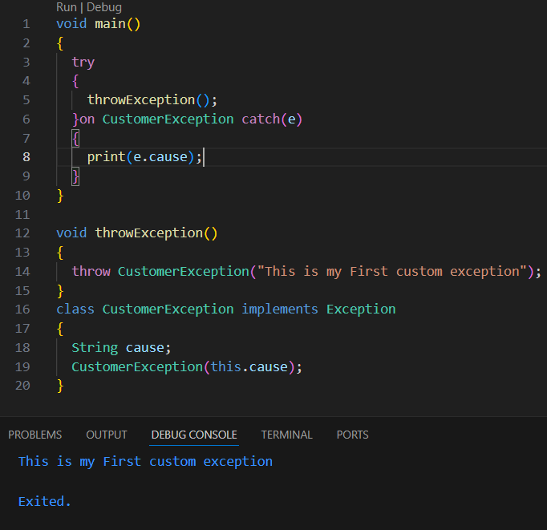
CUSTOM EXCEPTION
A custom exception is an exception that you create yourself to handle specific error situations in your program that are not covered by built-in exceptions.

Slide 7
CUSTOM EXCEPTION
KEYWORD | DESCRIPTION | EXAMPLE SNIPPET
class | Used to define a new user-defined data type that can contain variables, methods, and constructors. | class AgeException implements Exception { ... }
constructor | A special method that is automatically called when an object of the class is created. | AgeException(this.message);
implements | Used when a class wants to implement an interface or another class. | class AgeException implements Exception { ... }
throw | Used to raise (throw) an exception when an error condition occurs. | throw AgeException("Age must be 18 or above.");

Slide 8
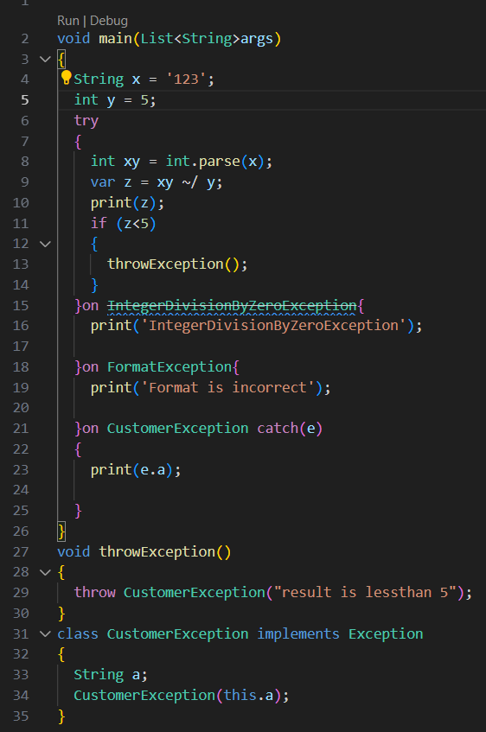
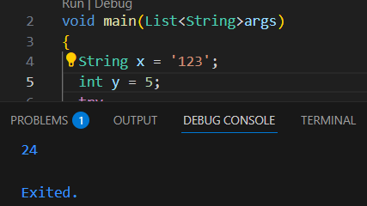
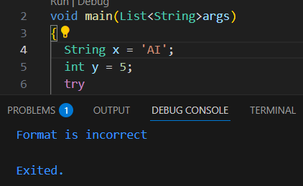
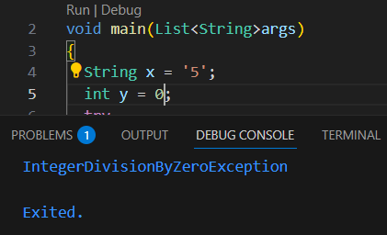
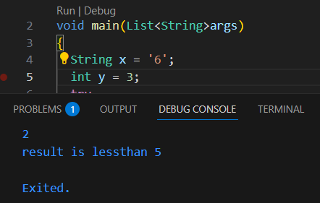
EXERCISE

Slide 9
THANK
YOU!!

